Slide 1
Lecture 1:
Introduction to Sociology
Course: Introduction to Human Sciences

Slide 2
What is Sociology?
Study of societies.
Study of individuals and groups.
Understanding/theorising society. Role of social structures, institutions, cultures.
Understanding the relationship between individuals and the larger society around them.
Do we all do sociology in our everyday conversations and interactions? Is sociology merely ‘common sense’?

Slide 3
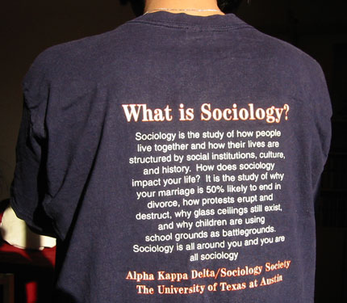

Slide 4
Some Concerns/Issues…
Social Institutions/Structures
Caste
Class
Tribe/Ethnicity
Gender
Religion
Family
Social Processes
  Exercise of Power, Authority
  Urbanisation/Migration
  Development/Industrialization
  Society and Ecological change
Change, Resistance and Mobility. Social Movements

Slide 5
What is the ‘Sociological Imagination’?
We are always participating in something larger than ourselves, and if we want to understand social life and what happens to people in it, we have to understand what it is we’re participating in and how we participate….
- Allan Johnson in The Forests and Trees: Sociology as Life Practice
A sociological perspective helps us to understand how personal choice is shaped by society, social structures, institutions and social norms.
How does a sociologist think?
Peter Berger first used the term "sociological perspective".
Seeing "the general in the particular".
Locating general patterns in the behavior of specific individuals. Ex. Hurricane Katrina and its response, caste in India, patriarchy.

Slide 6
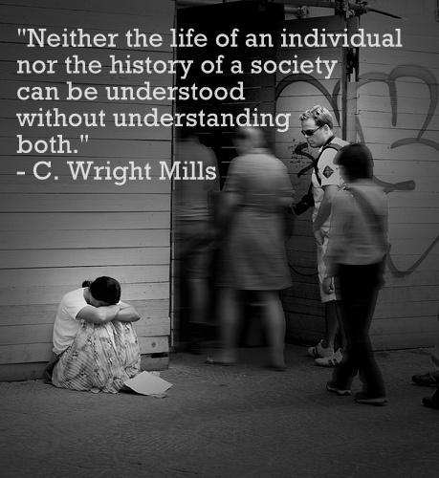
‘Sociological Imagination’
Social Systems
Individuals
As we participate in systems, our lives are shaped by socialization, and paths of least resistance.
We make social systems happen.

Slide 7
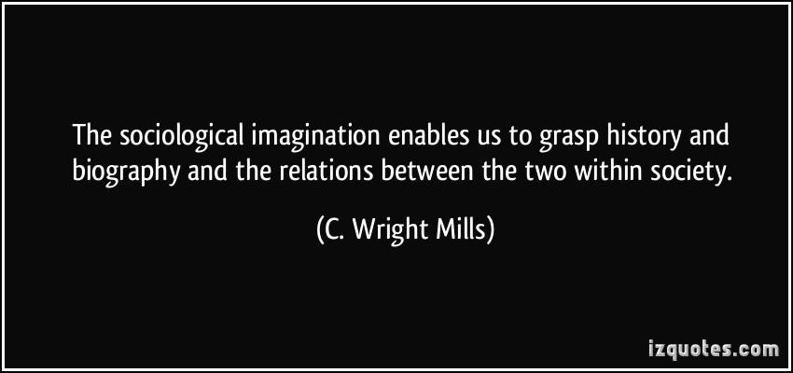

Slide 8
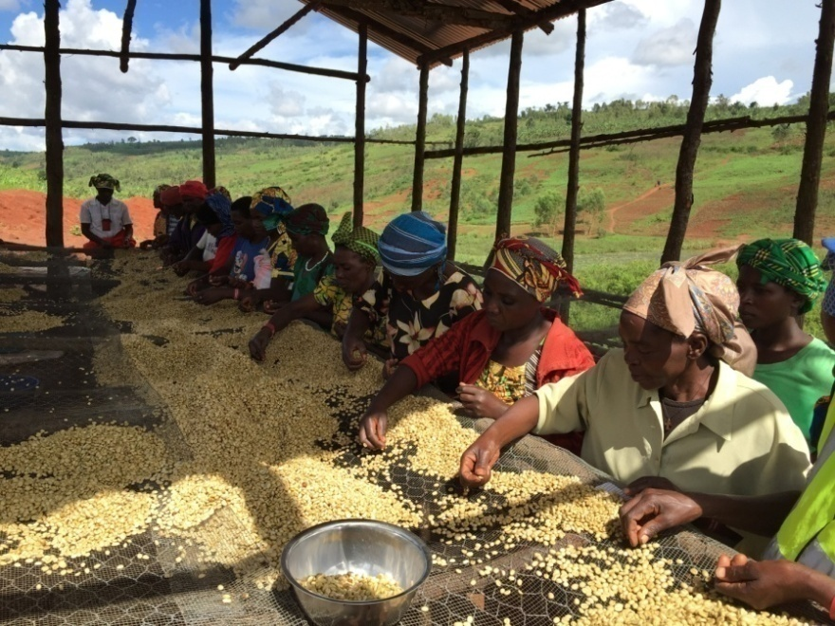
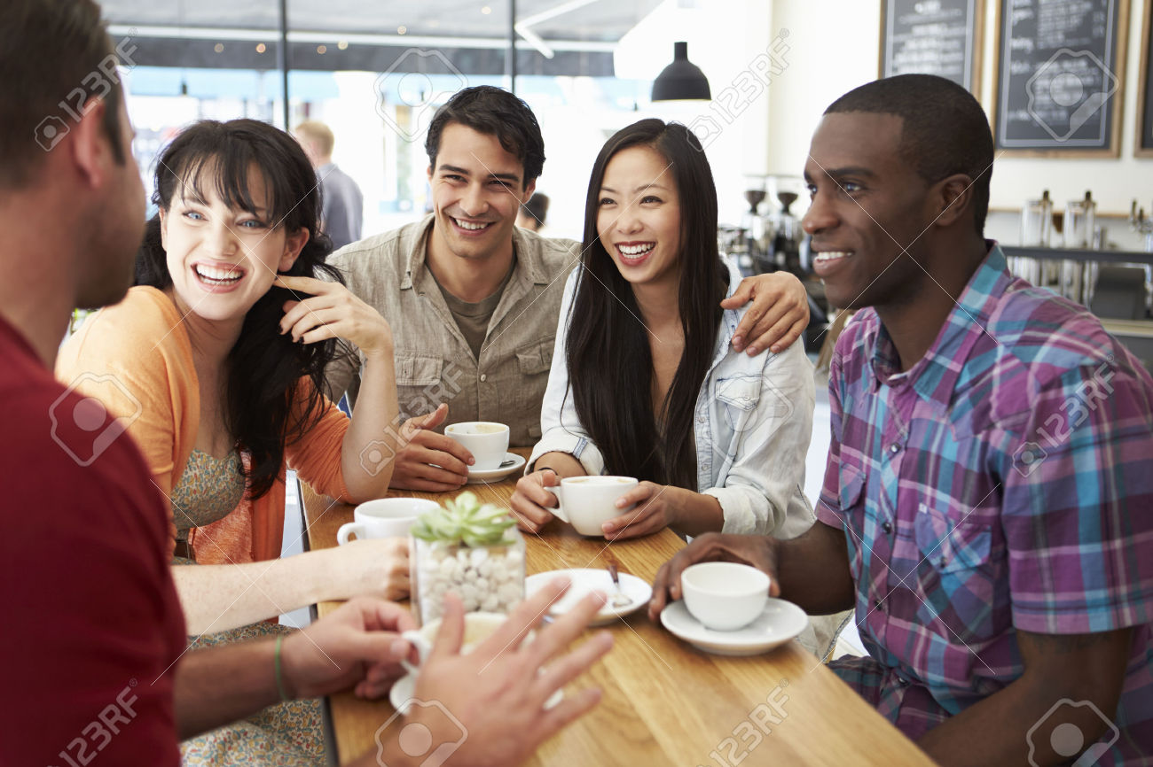
Looking for ‘sociological imagination’
Drinking Coffee
Coffee as refreshment, something to energize the self.
Coffee as ‘symbol’: Social world of ‘drinking’ coffee.
Coffee as routine: The ritual of coffee drinking. Coffee/marijuana.
Coffee as product: The social/economic world of coffee.
Coffee in societies. The process of ‘naturalisation’ of coffee.

Slide 9
Looking for ‘sociological imagination’
Education in a college/University
College as spaces to produce/disseminate knowledge.
College as tool for social mobility.
College as a meeting ground/melting pot of diverse cultures.
College as symbols/spaces of dissent. Speaking truth to power.

